Slide 1
Mathematics for Business Analytics and Finance
Sami Najafi
MSIS2402/2502
Module 1

Slide 2
Introduction
Sami Najafi
MS, Industrial Engineering
Sharif University of Technology, Tehran, Iran
MS and PhD, Management Science and Operations
London Business School (LBS), London, UK
Postdoctoral Fellow in Operations Management
University of Toronto , Toronto, Canada
Associate Professor of Operations Management at Leavey
Research interests:
Stochastic Modelling, Optimization
Pricing and Revenue Management, Service Operations
Operations-Marketing interface: Online Advertising

Slide 3
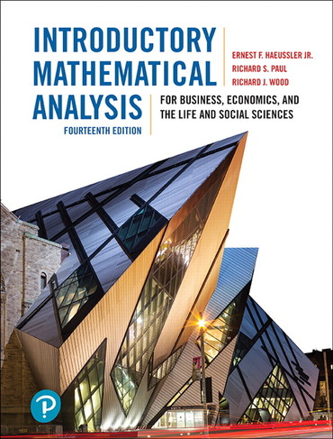

Course Material
Lecture slides, excel files, and all other teaching materials:
Posted on the course page
Recommended Optional Textbooks:
Modules 1-4: Introductory mathematical analysis for business, economics and the life and social sciences (14th Ed.)
By by Ernest F Haeussler, Richard S. Paul, Richard J. Wood. Pearson (July 24th 2018)
Modules 5-9: Basic business statistics: Concepts and applications. Pearson higher education (13th Ed.).
Berenson, M., Levine, D., Szabat, K. A., & Krehbiel, T. C. (2014). Pearson (2014)

Slide 4

Course Material
Recommended book for R:
R Cookbook: Proven Recipes for Data Analysis, Statistics, and Graphics, 2nd edition
By J.D. Long and Paul Teetor (2019)

Slide 5
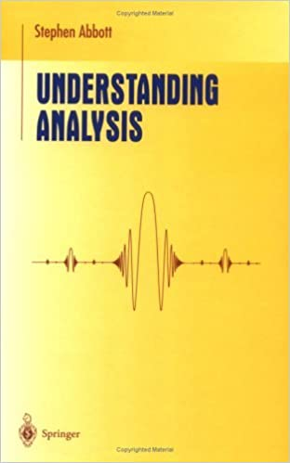
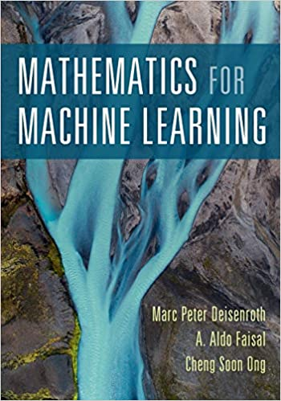
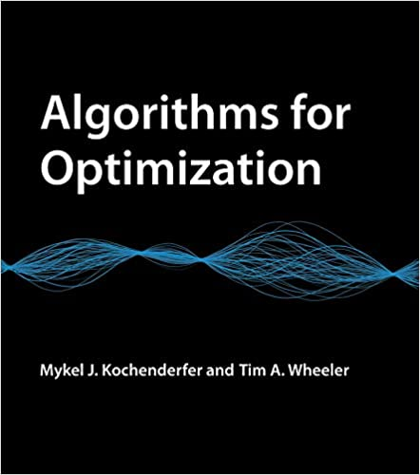
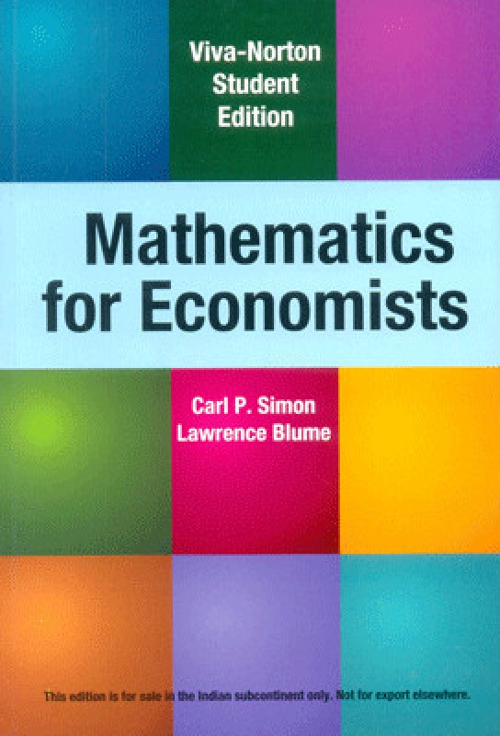

Additional References
For Calculus, Matrix Algebra, and Optimization
Abbott, Stephen. Understanding analysis. Vol. 2. New York: Springer, 2001.
Deisenroth, Marc Peter, A. Aldo Faisal, and Cheng Soon Ong. Mathematics for machine learning. Cambridge University Press, 2020.
Kochenderfer, Mykel J., and Tim A. Wheeler. Algorithms for optimization. Mit Press, 2019.
Simon Carl P, and Lawrence Blume. Mathematics for Economists, Norton & Company, Inc, 2010
Jehle, Geoffrey, Philip Reny. Advanced microeconomic theory. Pearson, 2010.

Slide 6
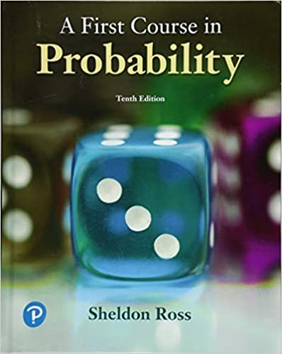

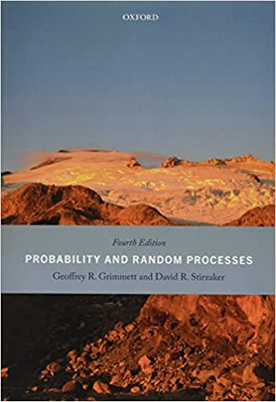
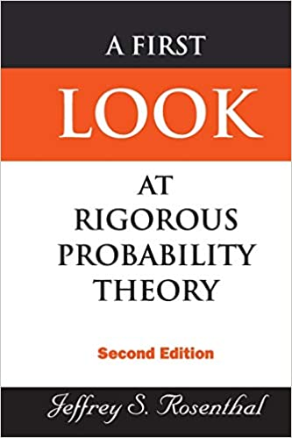

Additional References
For Probability
Ross, Sheldon M. A first course in probability. Boston: Pearson, 2019.
Ross, Sheldon M. Introduction to probability models. Academic press, 2014.
Grimmett, Geoffrey, and David Stirzaker. Probability and random processes. Oxford university press, 2020.
Durret, R. Probability: Theory and Examples, Cambridge University Press, 2020.
Rosenthal, Jeffrey S. First Look At Rigorous Probability Theory, A. World Scientific Publishing Company, 2006.

Slide 7
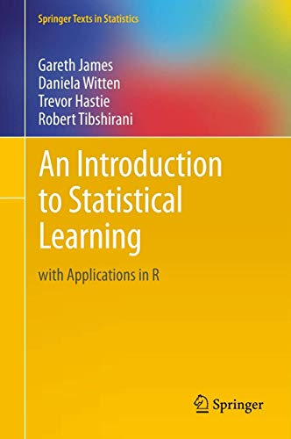
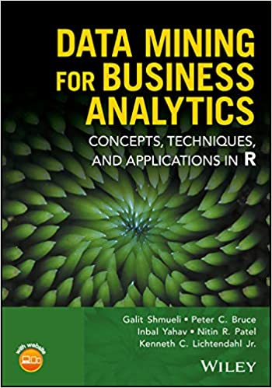
Additional References
For More Coding in R Especially for Data Science
James, G., Witten, D., Hastie, T., & Tibshirani, R. (2021). An Introduction to Statistical Learning: with Applications in R (Springer Texts in Statistics) 2nd ed.
Shmueli, Galit, et al. Data mining for business analytics: concepts, techniques, and applications in R. John Wiley & Sons, 2017.

Slide 8
Course Grading and Expectations
Fair grading, and communicating clearly the expectations of the course
Grading Breakdown:
Attendance | 10%
Weekly Assignments | 30%
Group Project | 20%
Midterm Exam | 20%
Final Exam | 20%

Slide 9
Attendance
Accounts for 10% of your final grade.
Missed Classes:
Absences will reduce your grade proportionally.
Exceptions: Documented medical or extenuating circumstances.
Grace Period & Late Policy:
15-minute grace period allowed
Arriving after grace period = “Late”
3 “Late” = 1 Absence
Exceptions: Documented extenuating circumstances

Slide 10
Weekly Assignments
Accounts for 30% of your final grade; 14 problem sets
Scoring:
Attempt each set twice; higher score is retained
Submit detailed solutions for partial credit
Due Dates:
End of the day on Sundays
Late Submission Policy
Daily Penalty:
10% per day after due date
Exceptions:
Medical emergencies
Extenuating circumstances
Subject to my discretion

Slide 11
Midterm/Final Exam
Each accounts for 20% of your final grade
Coverage:
Midterm: Modules 1-4
Final: Modules 5-8
Format:
In-class, closed-book, written
Questions similar to weekly assignments
Permitted Materials:
Handwritten notes (a maximum of 2 Letter-sized sheets)
One calculator (any type is ok)
Not Permitted:
Other electronic devices (laptops, cellphones, smartwatch, etc)
Internet access

Slide 12
Group Project
Constitutes 20% of your final grade.
Topic and Format:
Focus on optimizing support staffing decisions at Tesla to minimize operational costs.
Use R programming to solve this optimization problem.
Teams may consist of 2 to 4 students.
The case study story is not real but it simulates real-world complexities.

Slide 13
Learning Objectives: Tools and Techniques
Students will acquire proficiency in the following key areas:
Single variable calculus
Matrix algebra
Multivariable calculus and optimization
Probability and statistics
These competencies are essential for a comprehensive understanding of quantitative topics in:
Analytics
Finance
Marketing
Economics

Slide 14
Course Outline

Slide 15
Key Reminders on Functions and Limits

Slide 16
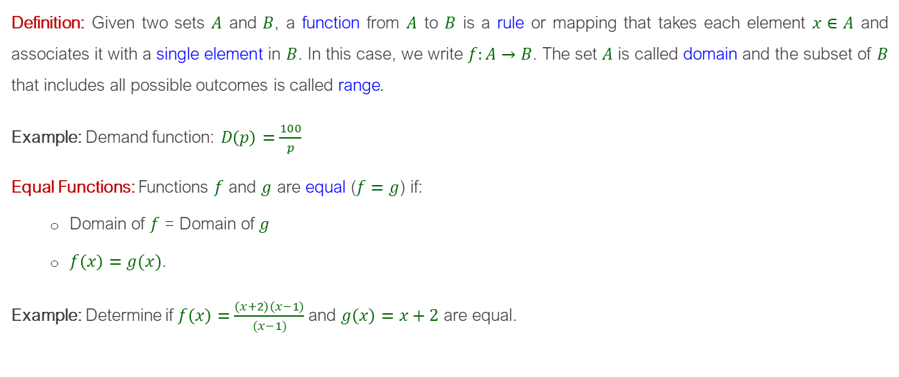
Functions
Definition: Given two sets $A$ and $B$, a function from $A$ to $B$ is a rule or mapping that takes each element $x∈A$ and associates it with a single element in $B$. In this case, we write $f:A→B$. The set $A$ is called domain and the subset of $B$ that includes all possible outcomes is called range.
Example: Demand function: $D\left(p\right)=\frac{100}{p}$
Equal Functions: Functions $f$ and $g$ are equal ($f=g$) if:
Domain of $f$ = Domain of $g$
$f\left(x\right)=g(x)$.
Example: Determine if $f\left(x\right)=\frac{\left(x+2\right)\left(x−1\right)}{(x−1)}$and $g\left(x\right)=x+2$ are equal.

Slide 17
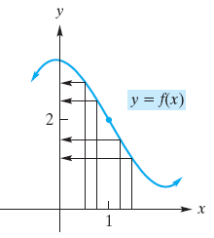
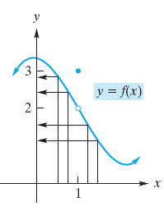
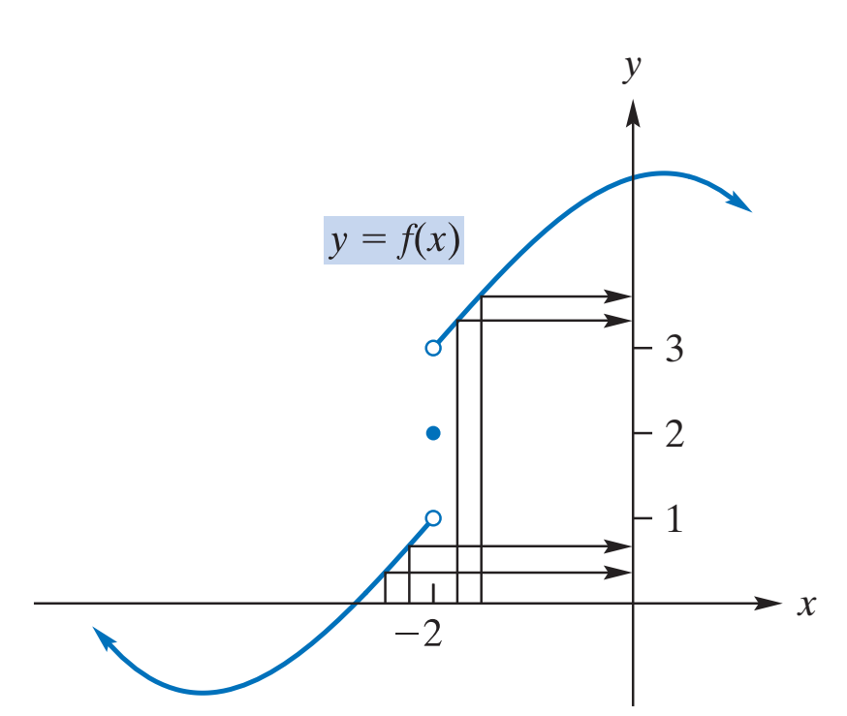
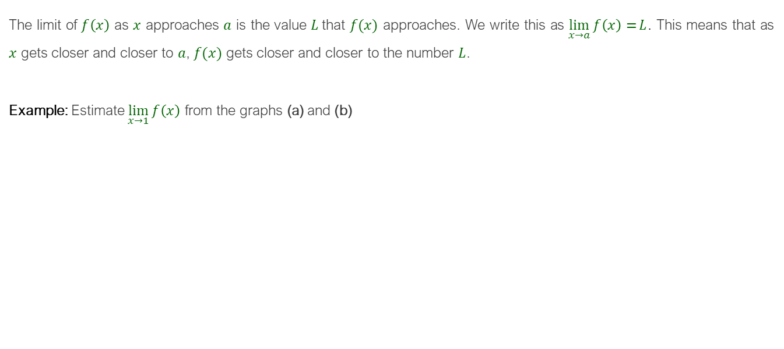
Limits
The limit of $f\left(x\right)$ as $x$ approaches $a$ is the value $L$that $f(x)$ approaches. We write this as $\lim_{x→a}{f\left(x\right)=}L$. This means that as $x$ gets closer and closer to $a$, $f(x)$ gets closer and closer to the number $L$.
Example: Estimate $\lim_{x→1}{f\left(x\right)}$ from the graphs (a) and (b)
(a)
(b)
(c)

Slide 18
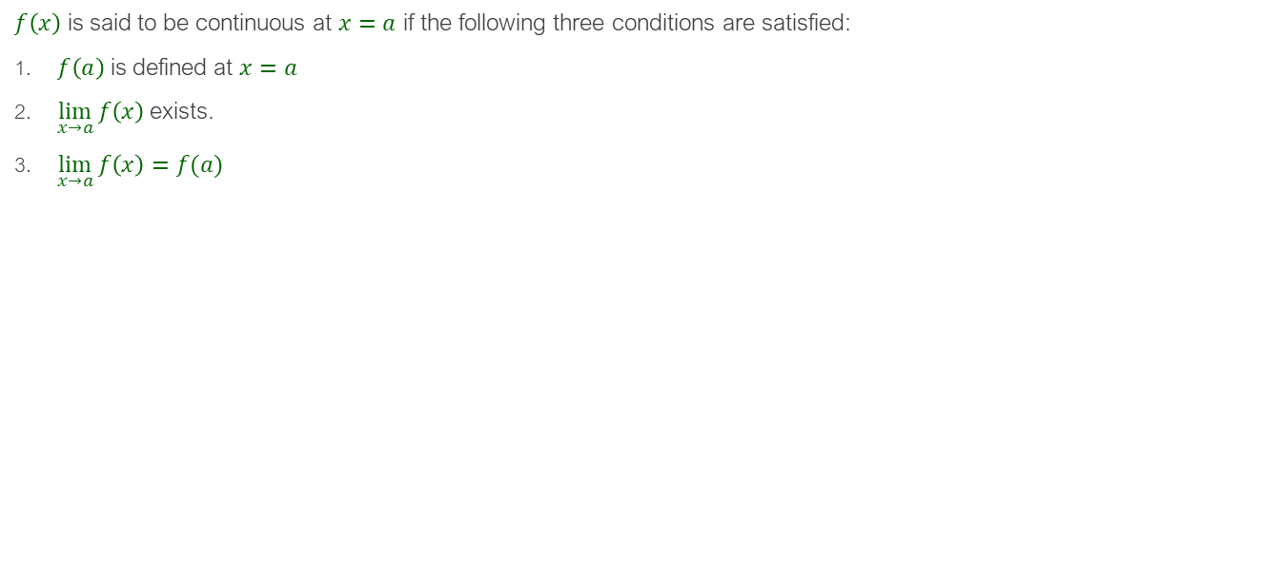
Continuity
$f\left(x\right)$ is said to be continuous at $x=a$ if the following three conditions are satisfied:
$f\left(a\right)$ is defined at $x=a$
$\lim_{x→a}{f\left(x\right)}$exists.
$\lim_{x→a}{f\left(x\right)}=f(a)$
(a)
(b)

Slide 19
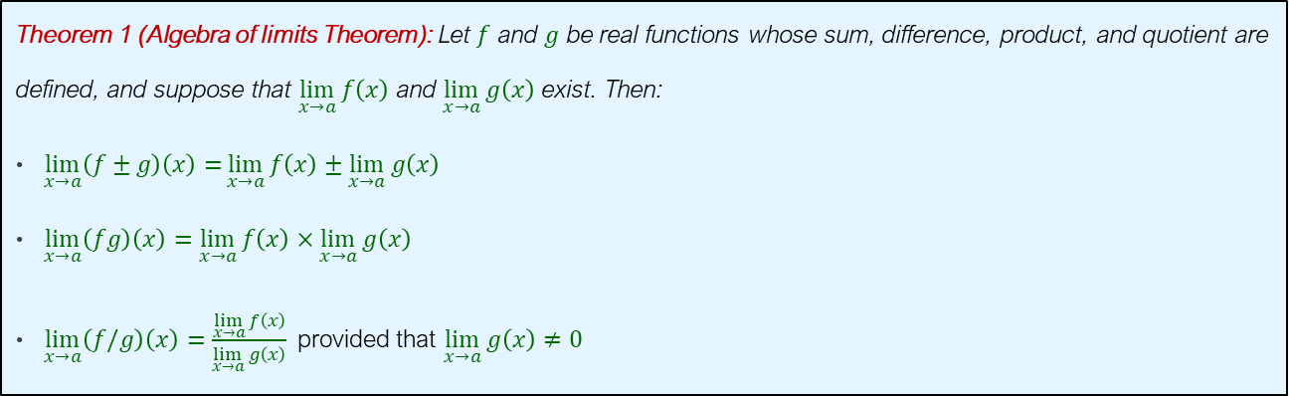
Properties of Limits
During some of the proofs throughout the course we will use the following properties of limits:
Theorem 1 (Algebra of limits Theorem): Let $f$ and $g$ be real functions whose sum, difference, product, and quotient are defined, and suppose that $\lim_{x→a}{f\left(x\right)}$ and $\lim_{x→a}{g\left(x\right)}$ exist. Then:
$\lim_{x→a}\left(f±g\right)\left(x\right)=\lim_{x→a}{f\left(x\right)}±\lim_{x→a}{g\left(x\right)}$
$\lim_{x→a}\left(fg\right)\left(x\right)=\lim_{x→a}{f\left(x\right)}×\lim_{x→a}{g\left(x\right)}$
$\lim_{x→a}\left(f/g\right)\left(x\right)=\frac{\lim_{x→a}{f\left(x\right)}}{\lim_{x→a}{g\left(x\right)}}$provided that $\lim_{x→a}{g\left(x\right)}≠0$

Slide 20
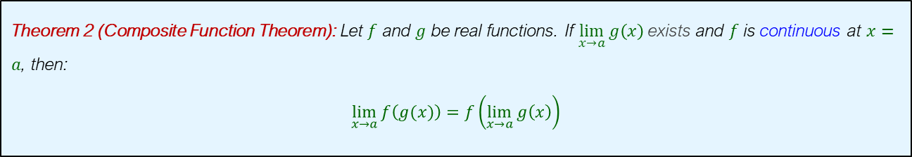
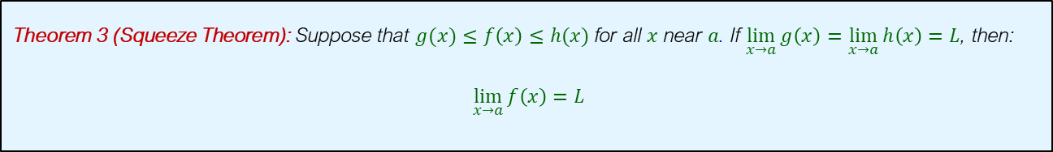
Properties of Limits
Theorem 2 (Composite Function Theorem): Let $f$ and $g$ be real functions. If $\lim_{x→a}{g\left(x\right)}$ exists and $f$ is continuous at $x=a$, then:
$$\lim_{x→a}{f\left(g(x)\right)}=f\left(\lim_{x→a}{g\left(x\right)}\right)$$
Theorem 3 (Squeeze Theorem): Suppose that $g(x)≤f\left(x\right)≤h(x)$ for all $x$ near $a$. If $\lim_{x→a}{g\left(x\right)}=\lim_{x→a}{h\left(x\right)}=L$, then:
$\lim_{x→a}{f\left(x\right)}=L$

Slide 21
A Brief Guide to Programming in R

Slide 22
Entering Commands and Getting Help
Using R as A Calculator
> 1+1
[1] 2
> max(1,3,5)
[1] 5
> pi
[1] 3.141593
> sqrt(2)
[1] 1.414214
To know more about a function:
> help("mean") or > ?mean
> example(mean)

Slide 23
Printing Something
Print
print(x,number of digits)
Print(“expression”)
> print(sqrt(2),4)
[1] 1.414
The only way to print multiple items is to print them one at a time
> print("The zero occurs at"); print(2*pi); print("radians")
[1] "The zero occurs at"
[1] 6.283185
[1] "radians"

Slide 24
Printing Something
Concatenate
cat(num1/expr1, num2/expr2,…) combines multiple items into a continuous output
> cat("The zero occurs at", 2*pi, "radians.", "\n")
The zero occurs at 6.283185 radians.
> fib = c(0,1,1,2,3,5,8,13,21,34)
> cat("The first few Fibonacci numbers are:", fib, "...\n")
The first few Fibonacci numbers are: 0 1 1 2 3 5 8 13 21 34 ...
> iter=1
> cat("iteration = ", iter = iter + 1, "\n")
iteration = 2

Slide 25
Variables
Defining Variables
Assignment operators: <- , <<- , = , -> , ->>.
> x <- 3
> z <- sqrt(x^2)
> print(z)
[1] 9
> f = 3
> print(f)
[1] 3
> 5 -> u
> print(u)
[1] 5

Slide 26
Variables
Deleting a Variable
rm(x) removes the variable
> x <- 2*pi
> x
[1] 6.283185
> rm(x)
> x
Error: object "x" not found

Slide 27
Functions
Defining a Function
function(param1, ...., paramN) expr
function(param1, ..., paramN) {
expr1
.
.
.
exprM
}
> cv = function(x) sd(x)/mean(x)
> cv(1:10)
[1] 0.5504819
s=function(n){
if(n>=5) return (2*n)
if((n>=0)&&(n<5))return (n)
else return (3*n)
}
> s(3)
[1] 3

Slide 28
Exponential Functions

Slide 29
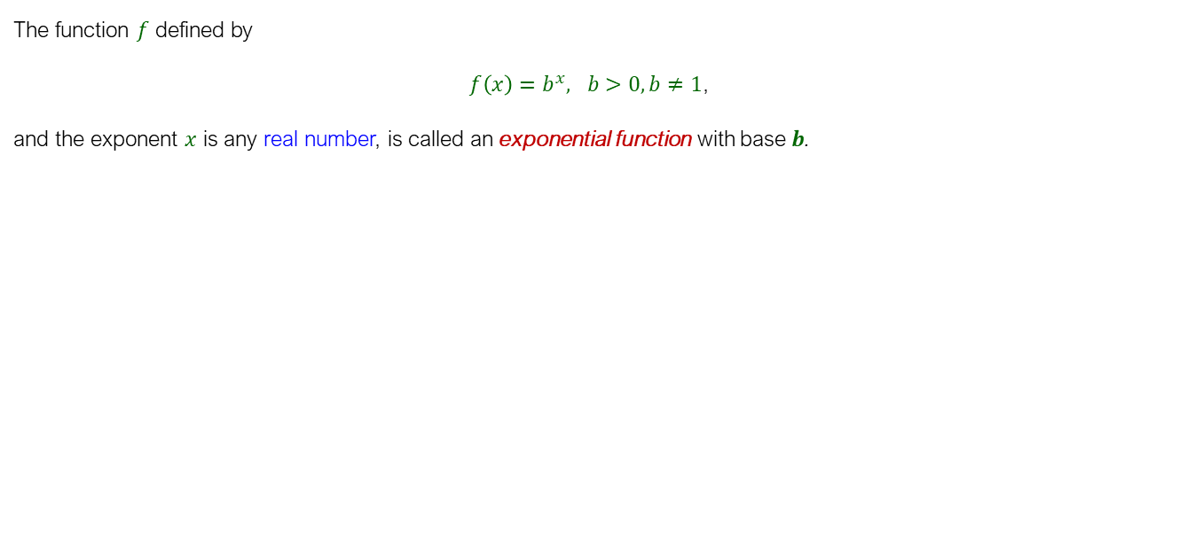




Exponential Functions
The function $f$ defined by
$f\left(x\right)=b^{x}, b>0, b≠1$,
and the exponent $x$ is any real number, is called an exponential function with base $b$.

Slide 30
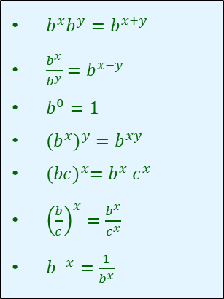

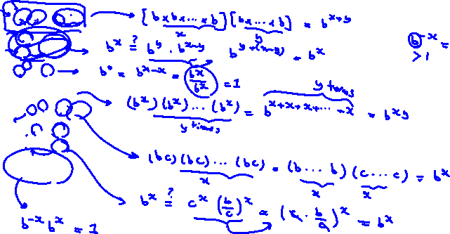
Properties of Exponential Functions
$b^{x}b^{y}=b^{x+y}$
$\frac{b^{x}}{b^{y}}=b^{x−y}$
$b^{0}=1$
${{(b}^{x})}^{y}=b^{xy}$
${(bc)}^{x}=b^{x}$ $c^{x}$
${\left(\frac{b}{c}\right)}^{x}=\frac{b^{x}}{c^{x}}$
$b^{−x}=\frac{1}{b^{x}}$

Slide 31
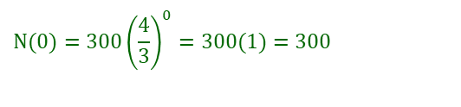

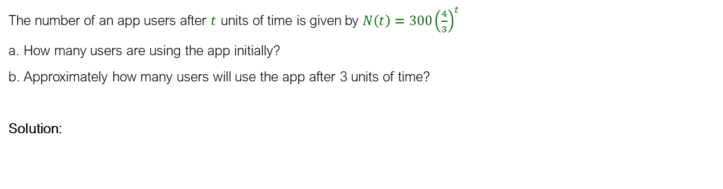

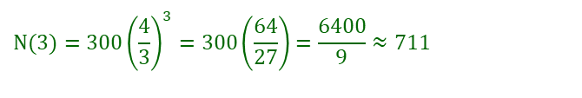
Example
The number of an app users after $t$ units of time is given by $N\left(t\right)=300{\left(\frac{4}{3}\right)}^{t}$
a. How many users are using the app initially?
b. Approximately how many users will use the app after 3 units of time?
Solution:
$$N(0)=300{\left(\frac{4}{3}\right)}^{0}=300(1)=300$$
$$N(3)=300{\left(\frac{4}{3}\right)}^{3}=300\left(\frac{64}{27}\right)=\frac{6400}{9}≈711$$

Slide 32

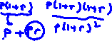

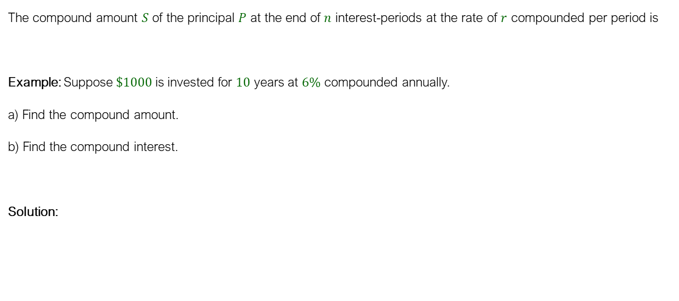
Compound Interest
The compound amount $S$ of the principal $P$ at the end of $n$ interest-periods at the rate of $r$ compounded per period is
Example: Suppose $\$1000$ is invested for $10$ years at $6\%$ compounded annually.
a) Find the compound amount.
b) Find the compound interest.
Solution:
$$S=P(1+r)^{n}$$
a) $S=P(1+r)^{n}=1000{\left(1+0.06\right)}^{10}=\$1790.85$
b) $Interest=S−P=1790.85−1000=\$790.85$

Slide 33
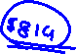


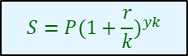

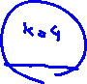
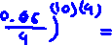


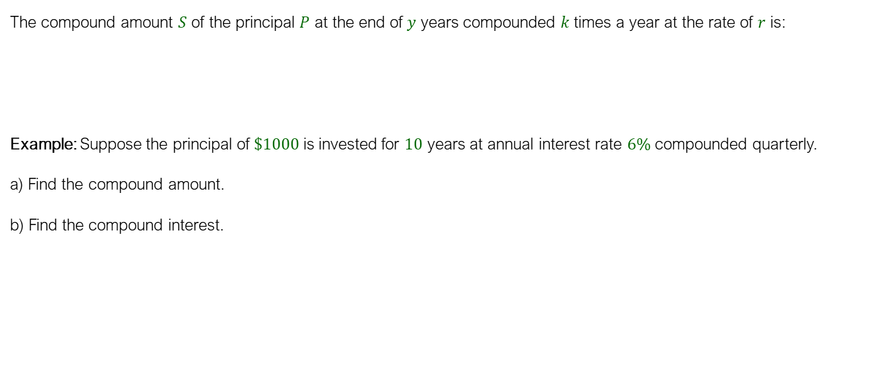
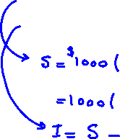
Compound Interest
The compound amount $S$ of the principal $P$ at the end of $y$ years compounded $k$times a year at the rate of $r$ is:
Example: Suppose the principal of $\$1000$ is invested for $10$ years at annual interest rate $6\%$ compounded quarterly.
a) Find the compound amount.
b) Find the compound interest.
$$S=P(1+\frac{r}{k})^{yk}$$

Slide 34
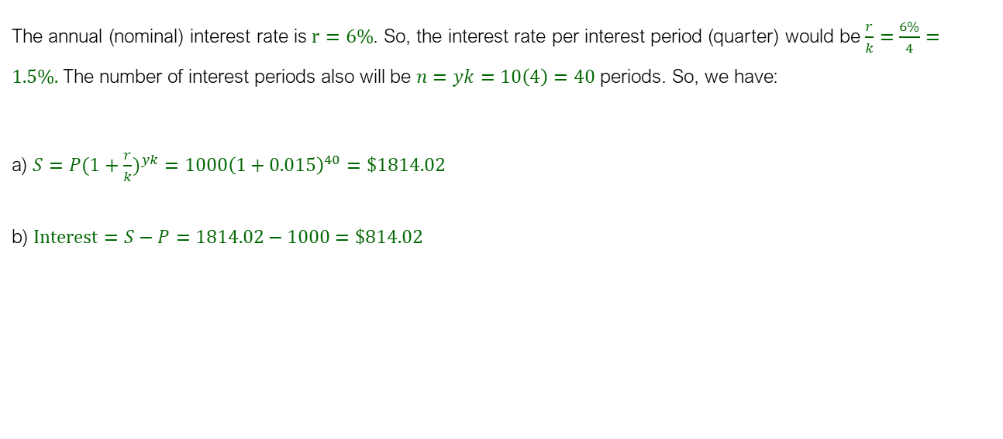
Solution
The annual (nominal) interest rate is $r=6\%$. So, the interest rate per interest period (quarter) would be $\frac{r}{k}=\frac{6\%}{4}=1.5\%.$The number of interest periods also will be $n=yk=10\left(4\right)=40$periods. So, we have:
a) $S=P(1+\frac{r}{k})^{yk}=1000{\left(1+0.015\right)}^{40}=\$1814.02$
b) $Interest=S−P=1814.02−1000=\$814.02$

Slide 35
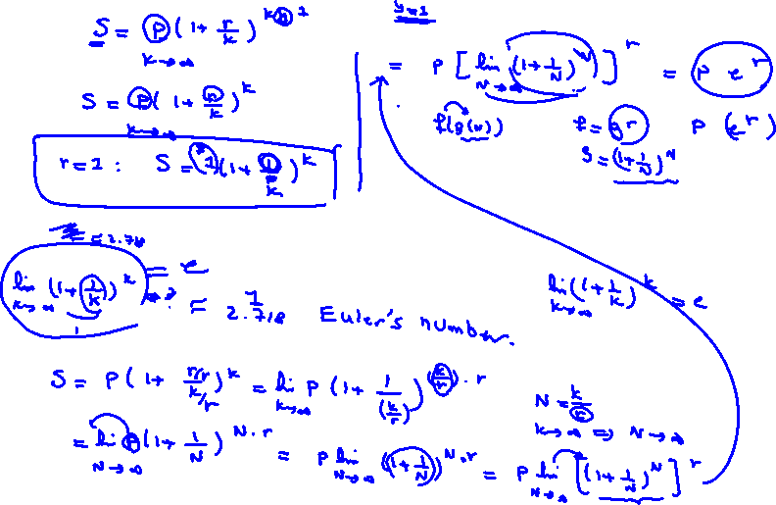
Compound Amount under Continuous Interest

Slide 36
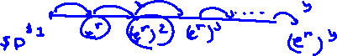

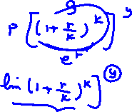
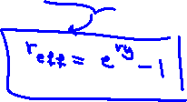



Slide 37
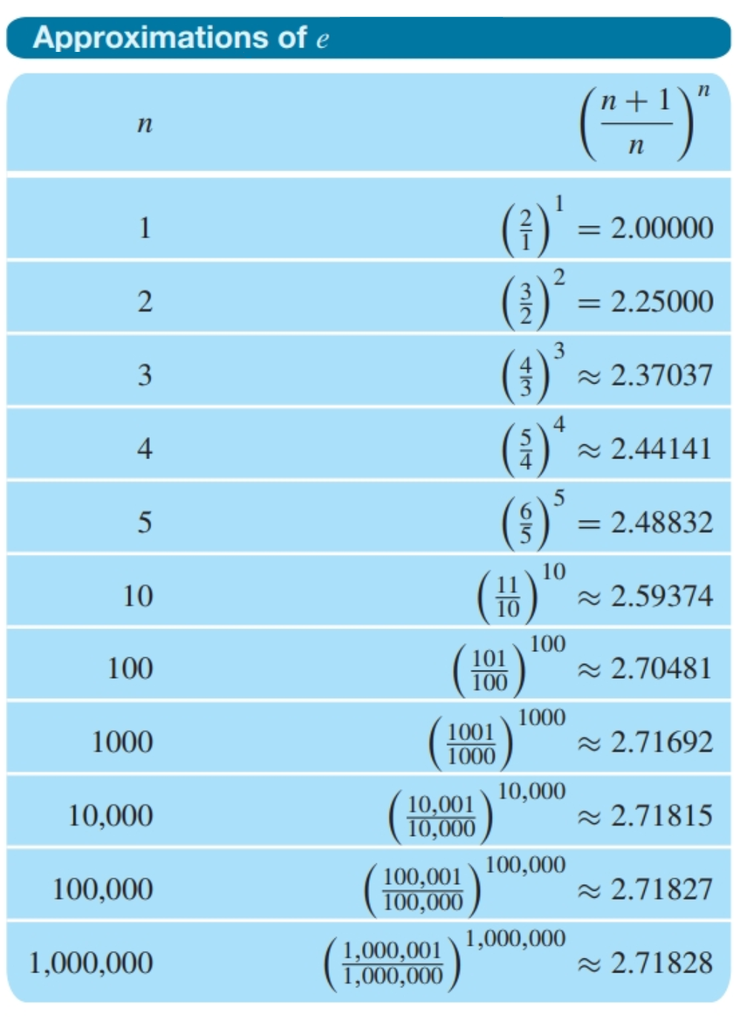

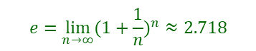
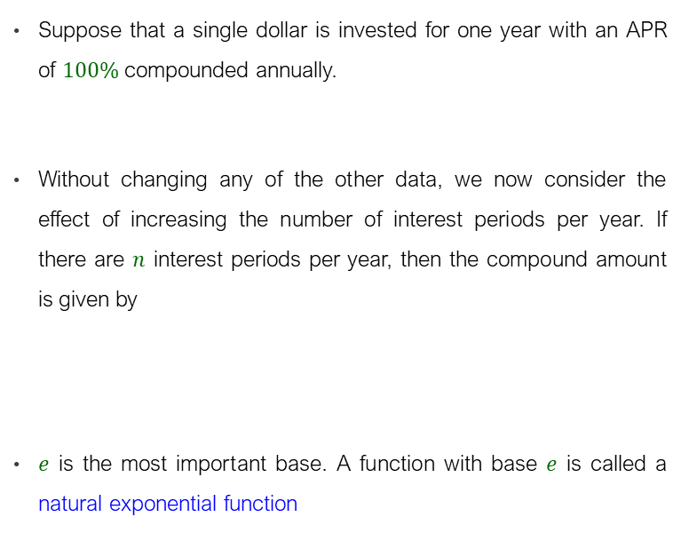

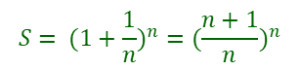
The Euler Number (e)
Suppose that a single dollar is invested for one year with an APR of $100\%$ compounded annually.
Without changing any of the other data, we now consider the effect of increasing the number of interest periods per year. If there are $n$ interest periods per year, then the compound amount is given by
$e$ is the most important base. A function with base $e$ is called a natural exponential function
$$S=(1)(1+1)^{1}=\$2$$
$$S= (1+\frac{1}{n})^{n}=(\frac{n+1}{n})^{n}$$
$$e=\lim_{n→∞}{(1+\frac{1}{n})^{n}≈2.718}$$
In R: $e^{x}=exp(x)$

Slide 38
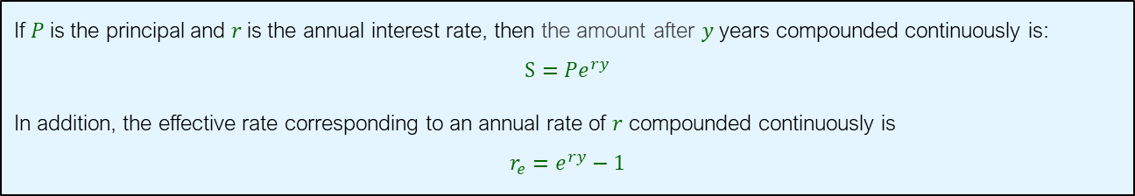
Compound Amount under Continuous Interest
If $P$is the principal and $r$is the annual interest rate, then the amount after $y$ years compounded continuously is:
$$S={Pe}^{ry}$$
In addition, the effective rate corresponding to an annual rate of $r$ compounded continuously is
$$r_{e}=e^{ry}−1$$

Slide 39
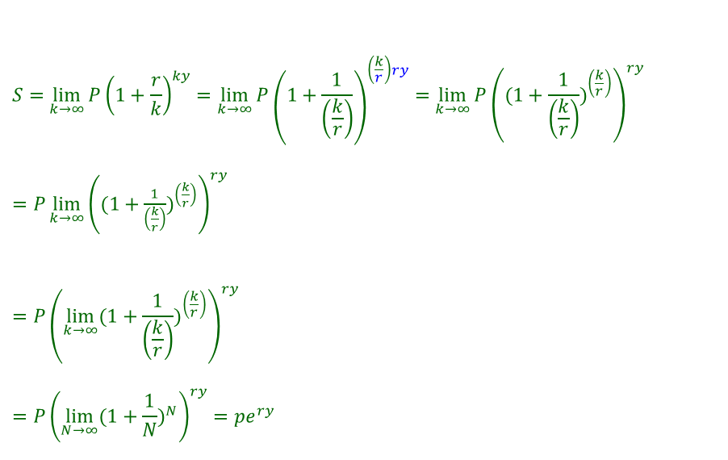
Compound Amount under Continuous Interest
$$S=\lim_{k→∞}{P{\left(1+\frac{r}{k}\right)}^{ky}}=\lim_{k→∞}{P{\left(1+\frac{1}{\left(\frac{k}{r}\right)}\right)}^{\left(\frac{k}{r}\right)ry}}=\lim_{k→∞}{P{\left((1+\frac{1}{\left(\frac{k}{r}\right)})^{\left(\frac{k}{r}\right)}\right)}^{ry}}$$
$=P\lim_{k→∞}{{\left((1+\frac{1}{\left(\frac{k}{r}\right)})^{\left(\frac{k}{r}\right)}\right)}^{ry}}$
$$={P\left(\lim_{k→∞}(1+\frac{1}{\left(\frac{k}{r}\right)})^{\left(\frac{k}{r}\right)}\right)}^{ry}$$
$$={P\left(\lim_{N→∞}(1+\frac{1}{N})^{N}\right)}^{ry}={pe}^{ry}$$
(Property of the exponential function)
(Algebraic Limit Theorem )
(Composite limit theorem)
(Change of variable and using the definition of $e$)

Slide 40
Logarithmic Functions

Slide 41

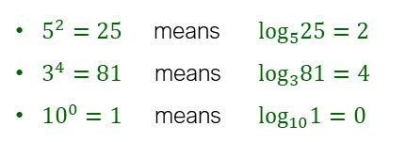


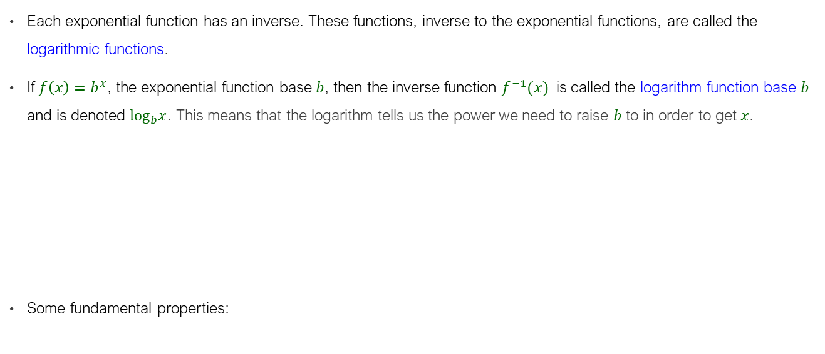
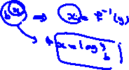




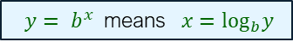



Logarithmic Functions
Each exponential function has an inverse. These functions, inverse to the exponential functions, are called the logarithmic functions.
If ${f\left(x\right)=b}^{x}$, the exponential function base $b$, then the inverse function $f^{−1}(x)$ is called the logarithm function base $b$ and is denoted $\log_{b}x$. This means that the logarithm tells us the power we need to raise $b$ to in order to get $x$.
Some fundamental properties:
$${ y= b}^{x} \text{means} x=\log_{b}y$$
In R: $\log_{b}x=log(x,b)$
$5^{2}=25 \text{means} log_{5}25=2$
$3^{4}=81 \text{means} log_{3}81=4$
$10^{0}=1 \text{means} log_{10}1=0$
$$\log_{b}b^{x}=x, b^{\log_{b}x}=x$$

Slide 42
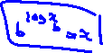
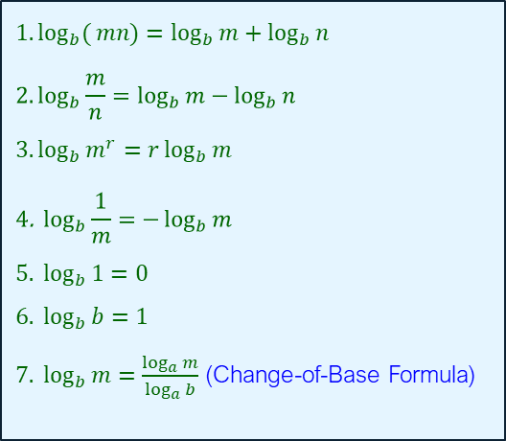








Properties of Logarithms
$$1. \log_{b}{(}mn)=\log_{b}{m}+\log_{b}{n}$$
$$2.\log_{b}\frac{m}{n}=\log_{b}{m}−\log_{b}{n}$$
$$3. \log_{b}{m^{r}}=r\log_{b}{m}$$
$$4\text{. }\log_{b}{\frac{1}{m}}=−\log_{b}{m} \\ 5. \log_{b}{1}=0 \\ 6. \log_{b}{b}=1$$ $7. \log_{b}{m}=\frac{\log_{a}{m}}{\log_{a}{b}}$ (Change-of-Base Formula)

Slide 43








Example
Simplify the following terms:
a) $\ln{\frac{x}{zw}}$
b) $\ln{\sqrt[3]{\frac{x^{5}(x−2)^{8}}{x−3}}}$

Slide 44

Solution
a)
$$\ln{\frac{x}{zw}}=\ln{x}−\ln{(}zw)=\ln{x}−(\ln{z}+\ln{w)}=\ln{x}−\ln{z}−\ln{w}$$
b)
$$\ln{\sqrt[3]{\frac{x^{5}(x−2)^{8}}{x−3}}}={\ln\left[\frac{x^{5}(x−2)^{8}}{x−3}\right]}^{1/3}=\frac{1}{3}\ln{\frac{x^{5}(x−2)^{8}}{x−3}} \\ =\frac{1}{3}\{\ln{[}x^{5}(x−2)^{8}]−\ln{(}x−3)\} \\ =\frac{1}{3}[\ln{x^{5}}+\ln{(}x−2)^{8}−\ln{(}x−3)] \\ =\frac{1}{3}[5\ln{x}+8\ln{(}x−2)−\ln{(}x−3)]$$

Slide 45








Example
Simplify the following expressions:
$\ln{e^{3x}}$
$\log{1}+\log{1}000$
$\log_{7}{\sqrt[9]{7^{8}}}$
$\log_{3}\left(\frac{27}{81}\right)$
$\ln{e}+\log{\frac{1}{10}}$

Slide 46

Solution
$\ln{e^{3x}}=3x.$
$\log{1}+\log{1000}=0+\log{{10}^{3}}=0+3=3$
$\log_{7}{\sqrt[9]{7^{8}}}=\log_{7}{7^{8/9}}=\frac{8}{9}$
$\log_{3}\left(\frac{27}{81}\right)=\log_{3}\left(\frac{3^{3}}{3^{4}}\right)=\log_{3}{(}3^{−1})=−1$
$\ln{e}+\log{\frac{1}{10}}=\ln{e}+\log{10^{−1}}=1+\left(−1\right)=0$

Slide 47








Example
Find the solution for:
a) $5^{x}=2$
b) $5+(3)4^{x−1}=12.$
c) $\log_{2}x=5−\log_{2}(x+4)$

Slide 48



Solution
a)
b)
c)
$$5^{x}=2⇒\log{5^{x}}=\log{2}⇒x\log{5}=\log{2}⇒x=\frac{\log{2}}{\log{5}}≈0.4307$$
$$5+(3)4^{x−1}=12⇒4^{x−1}=\frac{7}{3}⇒\ln{4^{x−1}}=\ln{\frac{7}{3}}⇒ x≈1.61120$$
$\log_{2}x=5−\log_{2}\left(x+4\right)⇒\log_{2}x+\log_{2}\left(x+4\right)=5⇒\log_{2}x\left(x+4\right)=5$ $⇒x\left(x+4\right)=2^{5}$
$⇒x^{2}+4x−32=0$ $⇒(x+8)(x−4)=0$
$$⇒x=−8 or x=+4$$

Slide 49
Definition of Derivatives as the Slope of the Tangent Line

Slide 50




The Derivative
A main objective of differential calculus is to find the slope of the tangent line to a curve at a specific point.
Tangent Line: A line that touches a curve at exactly one point and has the same direction as the curve at that point.
To obtain a suitable definition of tangent line, we use the limit concept and the geometric notion of a secant line.
A secant line is a line that intersects a curve at two or more points.
If $Q$ is a different point on the curve, the line $PQ$ is a different secant line.

Slide 51




The Derivative
If $Q$ moves along the curve and approaches $P$ from the right, typical secant lines are $PQ$, $PQ′′$, and so on. As $Q$ approaches $P$ from the left, typical secant lines are $PQ_{1}$, $PQ_{2}$, and so on. In both cases, the secant lines approach the same limiting position. This common limiting position of the secant lines is defined to be the tangent line to the curve at $P$.

Slide 52


The Derivative
A curve does not necessarily have a tangent line at each of its points.

Slide 53






The Derivative
The slope of a curve at $P$, if exits, is the slope of the tangent line at $P$.
The slope of the tangent line at $(a,f\left(a\right))$ is:
If $m_{tan}$exists, it is called the derivative of $f\left(x\right)$ at $x=a$ and is denoted with $f′\left(a\right)$.
$$m_{tan}=\lim_{z→a}{\frac{f\left(z\right)−f\left(a\right)}{z−a}=}\lim_{h→0}{\frac{f\left(a+h\right)−f\left(a\right)}{h}}$$

Slide 54



The Derivative
Key Takeaways:
Secant Line vs. Tangent Line: Secant line measures the average rate of change over an interval. Tangent line measures the instantaneous rate of change at a single point.
Role of Limits: The concept of a limit allows us to rigorously define the tangent line by considering what happens as $Q$ infinitely approaches $P$.

Slide 55




Example
Find the derivative of $f\left(x\right)=x^{2}$ at the point $x=1$.

Slide 56
Solution
$$f^{′}\left(1\right)=m=\lim_{h→0}{\frac{f\left(1+h\right)−f\left(1\right)}{h}}=\lim_{h→0}{\frac{{\left(1+h\right)}^{2}−{\left(1\right)}^{2}}{h}}=\lim_{h→0}{\frac{h^{2}+2h}{h}}=\lim_{h→0}\left(h+2\right)=2$$

Slide 57









Example
Find $\frac{d}{dx}\left(2x^{2}+2x+3\right)$.

Slide 58

Solution
$$f′\left(x\right)=\lim_{h→0}{\frac{f\left(x+h\right)−f\left(x\right)}{h}}=\lim_{h→0}{\frac{\left(2{\left(x+h\right)}^{2}+2\left(x+h\right)+3\right)−\left(2x^{2}+2x+3\right)}{h}}=4x+2$$
$$f′\left(1\right)=4\left(1\right)+2=6$$

Slide 59







Differentiability and Continuity
If $f\left(x\right)$ is differentiable at $x=a$, it is continuous at $x=a$.
$$f^{′}\left(a\right)=\lim_{h→0}{\frac{f\left(a+h\right)−f\left(a\right)}{h}⇒\lim_{h→0} f\left(a+h\right)−f\left(a\right)}= f^{′}\left(a\right)×\lim_{h→0}h=0⇒\lim_{h→0} f\left(a+h\right)=f\left(a\right)$$
If $f\left(x\right)$ is continuous at $x=a$, it is might not be differentiable at $x=a$.
If $f\left(x\right)$ is not continuous at $x=a$, it is not differentiable at $x=a$.

Slide 60
Rules for Differentiation
Part 1

Slide 61






Rules for Differentiation
$\frac{d}{dx}\left(c\right)=0$
$\frac{d}{dx}\left(x^{n}\right)=nx^{n−1}$
$\frac{d}{dx}\left(cf\left(x\right)\right)=cf′\left(x\right)$
$\frac{d}{dx}\left(f\left(x\right)±g\left(x\right)\right)=f′\left(x\right)±g′\left(x\right)$

Slide 62


Rules for Differentiation
Remark:
$x^{n}−y^{n}=(x−y)(x^{n−1}+x^{n−2}y+…+{{xy}^{n−1}+y}^{n−1})$
${f\left(x\right)=c⇒f}^{′}\left(x\right)=\lim_{h→0}{\frac{c−c}{h}}=0$
${f\left(x\right)=x^{n}⇒f}^{′}\left(x\right)=\lim_{h→0}{\frac{{\left(x+h\right)}^{n}−x^{n}}{h}}=\lim_{h→0}{\frac{h\left[{(x+h)}^{n−1}+h{(x+h)}^{n−2}+…+h^{n−1}\right]}{h}=nx^{n−1}}$
${g\left(x\right)=cf(x)⇒g}^{′}\left(x\right)=\lim_{h→0}{\frac{g(x+h)−g(x)}{h}}=\lim_{h→0}{\frac{cf\left(c+h\right)−cf(x)}{h}}=c\lim_{h→0}{\frac{f\left(c+h\right)−f(x)}{h}}=cf^{′}\left(x\right)$
${F\left(x\right)=f\left(x\right)±g(x)⇒F}^{′}\left(x\right)=\lim_{h→0}{\frac{F(x+h)−F(x)}{h}}=\lim_{h→0}{\frac{f\left(x+h\right)±g\left(x+h\right)−(f\left(x\right)±g\left(x\right))}{h}}=\lim_{h→0}\left[\frac{f\left(x+h\right)±f\left(x\right)}{h}±\frac{g\left(x+h\right)±g\left(x\right)}{h}\right]=f^{′}\left(x\right)±g′(x)$

Slide 63




Rules for Differentiation
Example: Find the following derivatives:
$y=\sqrt{x}$
$h\left(x\right)=\frac{1}{x\sqrt{x}}$
$F\left(x\right)=3x^{5}+\sqrt{x}$

Slide 64

Solution
$y=\sqrt{x}⇒\frac{dy}{dx}=\frac{1}{2}x^{\left(1/2\right)−1}=\frac{1}{2\sqrt{x}}$
$h\left(x\right)=\frac{1}{x\sqrt{x}}⇒h^{′\left(x\right)}=\frac{d}{dx}\left(x^{−\frac{3}{2}}\right)=−\frac{3}{2}x^{\left(−\frac{3}{2}\right)−1}=−\frac{3}{2}x^{−\frac{5}{2}}$
$F\left(x\right)=3x^{5}+\sqrt{x}⇒F′\left(x\right)=\frac{d}{dx}\left(3x^{5}\right)+\frac{d}{dx}\left(x^{1/2}\right)=3\left(5x^{4}\right)+\frac{1}{2}\left(x^{−1/2}\right)=15x^{4}+\frac{1}{2\sqrt{x}}$

Slide 65




Rules for Differentiation
$\frac{d}{dx}\left(f\left(x\right)g\left(x\right)\right)=f′\left(x\right)g\left(x\right)+f\left(x\right)g′\left(x\right)$ (Product Rule)

Slide 66


Product Rule
$\frac{d}{dx}\left(f\left(x\right)g\left(x\right)\right)=f′\left(x\right)g\left(x\right)+f\left(x\right)g′\left(x\right)$ (Product Rule)
$F\left(x\right)=f\left(x\right)g\left(x\right)$
$$f′\left(x\right)=\lim_{h→0}{\frac{F(x+h)−F(x)}{h}}=\lim_{h→0}\frac{f\left(x+h\right)g(x+h)−f\left(x\right)g(x)}{h}=\lim_{h→0}\frac{f\left(x+h\right)g\left(x+h\right)−f\left(x+h\right)g\left(x\right)+f\left(x+h\right)g(x)−f\left(x\right)g(x)}{h}=\lim_{h→0}\left[f\left(x+h\right)\frac{g\left(x+h\right)−g(x) }{h}+g\left(x\right)\frac{f\left(x+h\right)−f(x) }{h}\right]=f′\left(x\right)g\left(x\right)+f\left(x\right)g′\left(x\right)$$

Slide 67



Rules for Differentiation
Example: Take the following derivatives using the product rule
a) $f\left(x\right)=\left(x^{2}+3x\right)\left(4x+5\right)$
b) $y=(x+2)(x+3)(x+4)$

Slide 68

Solution
a)
$$f′\left(x\right)=\left(\frac{d}{dx}\left(x^{2}+3x\right)\right)\left(4x+5\right)+\left(x^{2}+3x\right)\left(\frac{d}{dx}\left(4x+5\right)\right) \\ =\left(2x+3\right)\left(4x+5\right)+\left(x^{2}+3x\right)\left(4\right)=12x^{2}+34x+15$$
b)
$$y′=\left(\frac{d}{dx}\left(x+2\right)\left(x+3\right)\right)\left(x+4\right)+\left(\left(x+2\right)\left(x+3\right)\right)\left(\frac{d}{dx}\left(x+4\right)\right) \\ =3x^{2}+18x+26$$

Slide 69






Rules for Differentiation
$\frac{d}{dx}\left(\frac{f\left(x\right)}{g\left(x\right)}\right)=\frac{g\left(x\right)f^{′}\left(x\right)−f\left(x\right)g^{′}\left(x\right)}{{\left(g\left(x\right)\right)}^{2}}$ (Quotient Rule)

Slide 70

Rules for Differentiation
$\frac{d}{dx}\left(\frac{f\left(x\right)}{g\left(x\right)}\right)=\frac{g\left(x\right)f^{′}\left(x\right)−f\left(x\right)g^{′}\left(x\right)}{{\left(g\left(x\right)\right)}^{2}}$ (Quotient Rule)
$F\left(x\right)=\frac{f\left(x\right)}{g(x)}$
$$Fg=f⇒F^{′}g+Fg^{′}=f^{′}⇒F^{′}=\frac{f^{′}−Fg′}{g}=\frac{f^{′}−\left(\frac{f}{g}\right)g′}{g}=\frac{f^{′}g−fg^{′}}{g^{2}}$$

Slide 71

Rules for Differentiation
Example: If $f\left(x\right)=\frac{4x^{2}+3}{2x−1}$, find $f′\left(x\right)$.

Slide 72

Solution
$$f^{′}\left(x\right)=\frac{\left(2x−1\right)\frac{d}{dx}\left(4x^{2}+3\right)−\left(4x^{2}+3\right)\frac{d}{dx}\left(2x−1\right)}{{\left(2x−1\right)}^{2}}$$
$$=\frac{\left(2x−1\right)\left(8x\right)−\left(4x^{2}+3\right)\left(2\right)}{{\left(2x−1\right)}^{2}}$$
$$=\frac{2\left(2x+1\right)\left(2x−3\right)}{{\left(2x−1\right)}^{2}}$$

Slide 73










Slide 74








Rules for Differentiation
$\frac{dy}{dx}=\frac{dy}{du}⋅\frac{du}{dx}$ (The Chain Rule)
Example: Find $\frac{dy}{dx}$:
a) $y=2u^{2}−3u−2$ and ${u=x}^{2}+4$
b) ${y=w}^{1/2}$ and $w=7−x^{3}$
c) ${y=\left(x^{3}−1\right)}^{7}$

Slide 75

Solution
a)
$\frac{dy}{dx}=\frac{dy}{du}⋅\frac{du}{dx}=\frac{d}{du}\left(2u^{2}−3u−2\right)⋅\frac{d}{dx}\left(x^{2}+4\right)=\left(4u−3\right)\left(2x\right)=$ $\left(4x^{2}+13\right)\left(2x\right)$
$$\frac{dy}{dx}=\left[4\left(x^{2}+4\right)−3\right]\left(2x\right)=\left[\left(4x^{2}+13\right)\right]\left(2x\right)=8x^{3}+26x$$
b)
$\frac{dy}{dx}=\frac{d}{dw}\left(w^{1/2}\right)⋅\frac{d}{dt}\left(7−x^{3}\right)=−\frac{3x^{2}}{2\sqrt{w}}=−\frac{3x^{2}}{2\sqrt{7−x^{3}}}$
c)
$$\frac{dy}{dx}=\frac{d}{dx}\left(x^{3}−1\right)×7{\left(x^{3}−1\right)}^{7−1}=\left(3x^{2}\right)[7{\left(x^{3}−1\right)}^{6}]=21x^{2}{\left(x^{2}−1\right)}^{6}$$

Slide 76




Derivative as a Rate of Change
Applications in Economics:
Total-cost function $c\left(q\right)$: The total cost incurred in producing $q$ units
Marginal cost $c^{′}\left(q\right)=\frac{dc}{dq}$ $≈$ Additional cost incurred by producing one more unit.
Total-revenue function $r\left(q\right)$: The total revenue from selling $q$ units
Marginal revenue $r^{′}(q)= \frac{dr}{dq}$ $≈$ Additional revenue generated by selling one more unit.
Example: A manufacturer’s average-cost for producing $q$is given by:
$\bar{c}(q)=0.0001q^{2}−0.02q+5+\frac{5000}{q}$.
Find the marginal cost when $q=50$.

Slide 77

Solution
$$\bar{c}\left(q\right)=\frac{c\left(q\right)}{q}⇒c(q)=q\bar{c}(q)=q\left(0.0001q^{2}−0.02q+5+\frac{5000}{q}\right)=0.0001q^{3}−0.02q^{2}+5q+5000$$
$$⇒c′(q)=0.0003q^{2}−0.04q+5⇒c′(50)=0.0003{\left(50\right)}^{2}−0.04\left(50\right)+5=3.75$$

Slide 78
Rules for Differentiation
Part 2

Slide 79


Derivatives of Logarithmic Functions
$$\frac{d}{dx}\left(\ln{x}\right)=\frac{1}{x} , x>0$$
$$\frac{d}{dx}\left(\ln{u}\right)=\frac{1}{u}⋅\frac{du}{dx}\text{, } u>0$$

Slide 80


Derivatives of Logarithmic Functions
$$\frac{d}{dx}\left(\ln{x}\right)=\frac{1}{x} , x>0$$
$$\frac{d}{dx}\left(\ln{u}\right)=\frac{1}{u}⋅\frac{du}{dx}\text{, } u>0$$
$f\left(x\right)=\ln{x}$
$$f^{′}\left(x\right)=\lim_{h→0}{\frac{f(x+h)−f(x)}{h}}=\lim_{h→0}{\frac{ln(x+h)−ln(x)}{h}}=\lim_{h→0}{\frac{1}{h}ln\left(\frac{x+h}{x}\right)}=\lim_{h→0}\left[ln{\left(1+\frac{h}{x}\right)}^{\frac{1}{h}}\right]=\ln\left[\lim_{h→0}{\left(1+\frac{h}{x}\right)}^{\frac{1}{h}}\right]$$
Note that limit can go inside because of the Compositive Function Theorem for Limits ($f$ is a continuous function and the limit of the function inside $f$is defined- see the previous slides).
Now take $N=\frac{1}{h}$. Clearly when $h→0$ , then $N→∞$. Hence, from the definition of Euler number, we get:
$$f^{′}\left(x\right)=\ln\left[\lim_{N→∞}{\left(1+\frac{\left(\frac{1}{x}\right)}{N}\right)}^{N}\right]=ln\left(e^{\frac{1}{x}}\right)=\frac{1}{x}.$$

Slide 81


Derivatives of Logarithmic Functions
Example: Differentiate the following functions
a) $y=\frac{\ln{x}}{x^{2}}$
b) $y={\ln\left(2x+5\right)}^{3}$
c) $f\left(p\right)=\ln\left({\left(p+1\right)}^{2}{\left(p+2\right)}^{3}{\left(p+3\right)}^{4}\right)$

Slide 82

Solution
a) $y=\frac{\ln{x}}{x^{2}}⇒y′=\frac{x^{2}\frac{d}{dx}\left(\ln{x}\right)−\left(\ln{x}\right)\frac{d}{dx}\left(x^{2}\right)}{{\left(x^{2}\right)}^{2}}=\frac{x^{2}\left(\frac{1}{x}\right)−(\ln{x})\left(2x\right)}{x^{4}}=\frac{1−2\ln{x}}{x^{3}} \text{for} x>0$
b) $y={\ln\left(2x+5\right)}^{3}=3ln(2x+5)$ $⇒$ $\frac{dy}{dx}=3(2)\left(\frac{1}{2x+5}\right)=\frac{6}{2x+5} \text{for} x>−\frac{5}{2}$
c) $f\left(p\right)=\ln\left({\left(p+1\right)}^{2}{\left(p+2\right)}^{3}{\left(p+3\right)}^{4}\right)$
$$⇒f′\left(p\right)=2\left(\frac{1}{p+1}\right)\left(1\right)+3\left(\frac{1}{p+2}\right)\left(1\right)+4\left(\frac{1}{p+3}\right)\left(1\right)=\frac{2}{p+1}+\frac{3}{p+2}+\frac{4}{p+3}$$

Slide 83







Derivatives of Logarithmic Functions
Example: Find $\frac{d}{dx}\left(\log_{2}{x}\right)$.
Solution:
$$\frac{d}{dx}\left(\log_{2}{x}\right)=\frac{d}{dx}\left(\frac{\ln{x}}{\ln{2}}\right)=\frac{1}{\left(\ln{2}\right)x}$$
$$\frac{d}{du}\left(\log_{b}{u}\right)=\frac{d}{du}\left(\frac{\ln{u}}{\ln{b}}\right)=\frac{1}{\ln{b}}×\frac{d}{du}\left(ln u\right)$$

Slide 84














Derivatives of Exponential Functions
$\frac{d}{dx}\left(e^{x}\right)=e^{x}$
$\frac{d}{dx}\left(e^{u}\right)={\frac{du}{dx}e}^{u}$
$\frac{d}{dx}\left(b^{u}\right)={\frac{du}{dx}b}^{u}\left(\ln{b}\right)$
$\frac{dy}{dx}=\frac{1}{\frac{dx}{dy}}$

Slide 85


Derivatives of Exponential Functions
$\frac{d}{dx}\left(e^{x}\right)=e^{x}$
$\frac{d}{dx}\left(e^{u}\right)={\frac{du}{dx}e}^{u}$
$\frac{d}{dx}\left(b^{u}\right)={\frac{du}{dx}b}^{u}\left(\ln{b}\right)$
$\frac{dy}{dx}=\frac{1}{\frac{dx}{dy}}$
$y=e^{x}⇒lny=x⇒\frac{1}{y}\frac{dy}{dx}=1⇒\frac{dy}{dx}=y=e^{x}$
$y=b^{u}$ $⇒y=e^{ln\left(b^{u}\right)}=e^{u(lnb) }=e^{u_{1}},u_{1}=u\left(lnb\right)⇒\frac{dy}{dx}=\frac{dy}{du_{1}}×\frac{du_{1}}{du}×\frac{du}{dx} (chain rule)⇒\frac{dy}{dx}=e^{u\left(lnb\right)}\left(lnb\right)\frac{du}{dx}$
$y=f\left(x\right)⇒f^{−1}\left(y\right)=x⇒\frac{df^{−1}\left(y\right)}{dy}×\frac{dy}{dx}=1⇒\frac{dx}{dy}×\frac{dy}{dx}=1⇒\frac{dy}{dx}=\frac{1}{\frac{dx}{dy}}$

Slide 86


Derivatives of Exponential Functions
Example: Find $\frac{dy}{dx}$ when
$y=3e^{x}$.
$y=\frac{x}{e^{x}}$,
$y=e^{2}+e^{x}+\ln{3}$

Slide 87




Solution
a)
b)
c)
$$\frac{d}{dx}\left(3e^{x}\right)=3\frac{d}{dx}\left(e^{x}\right)=3e^{x}$$
$$\frac{dy}{dx}=e^{−x}\frac{d}{dx}x+x\frac{d}{dx}\left(e^{−x}\right)=\frac{1−x}{e^{x}}$$
$$y=e^{2}+e^{x}+\ln{3}$$
$$y′=0+e^{x}+0=e^{x}$$

Slide 88










Implicit Differentiation
Sometimes $y$ is not expressed as an explicit function of $x$. To determine $\frac{dy}{dx}$follow these steps:
Differentiate both sides with respect to $x$.
Collect all $\frac{dy}{dx}$terms on one side and solve for $\frac{dy}{dx}$.
Example: Find $\frac{dy}{dx}$ from
a) $y+y^{3}−x=7$.
b) $x^{3}={\left(y−x^{2}\right)}^{2}$ at $(1,2)$.

Slide 89

Solution
a)
$$\frac{d}{dx}\left(y+y^{3}−x\right)=\frac{d}{dx}\left(7\right)⇒\frac{dy}{dx}+3y^{2}\frac{dy}{dx}−1=0⇒\frac{dy}{dx}=\frac{1}{1+3y^{2}}$$
b)
$$\frac{d}{dx}\left(x^{3}\right)=\frac{d}{dx}\left[{\left(y−x^{2}\right)}^{2}\right]⇒3x^{2}=2\left(y−x^{2}\right)\left(\frac{dy}{dx}−2x\right)$$
$$⇒\frac{dy}{dx}=\frac{3x^{2}+4xy−4x^{3}}{2\left(y−x^{2}\right)}⇒{\left.\frac{dy}{dx}\right|}_{\left(1,2\right)}=\frac{7}{2}$$

Slide 90







Logarithmic Differentiation
Sometimes to differentiate a function $y=f(x)$, it is easier first to take natural log from both sides and take the derivative from the natural log function. In that case, follow these steps:
Take the natural logarithm of both sides which gives $\ln{y}=\ln\left(f\left(x\right)\right)$.
Differentiate both sides with respect to $x$.
Solve for $\frac{dy}{dx}$.
Example: Find $\frac{dy}{dx}$ for $y=\frac{{\left(2x−5\right)}^{3}}{x^{2}\sqrt[4]{x^{2}+1}}$

Slide 91

Solution
$$\ln{y}=\ln{\frac{{\left(2x−5\right)}^{3}}{x^{2}\sqrt[4]{x^{2}+1}}}⇒\ln{y}={\ln\left(2x−5\right)}^{3}−\ln{x^{2}}−ln\sqrt[4]{x^{2}+1}=3\ln\left(2x−5\right)−2\ln{x}−\frac{1}{4}ln(x^{2}+1)$$
$$⇒\frac{y′}{y}=3(2) (\frac{1}{2x−5}) −2(\frac{1}{x})−\frac{1}{4}(2x)(\frac{1}{x^{2}+1}) =\frac{6}{2x−5}−\frac{2}{x}−\frac{x}{2(x^{2}+1)}$$
$$⇒y′=\frac{(2x−5)^{3}}{x^{2}\sqrt[4]{x^{2}+1}}\left[\frac{6}{2x−5}−\frac{2}{x}−\frac{x}{2(x^{2}+1)}\right]$$

Slide 92
Unconstrained Optimization

Slide 93






Monotonic Function
Definition:
$f\left(x\right)$ is increasing if for any $x_{1}<x_{2}⇒f\left(x_{1}\right)<f\left(x_{2}\right)$
$f\left(x\right)$ is decreasing if for any $x_{1}<x_{2}⇒f\left(x_{1}\right)>f\left(x_{2}\right)$.
If $f\left(x\right)$is increasing, then: $f^{′}\left(x\right)≥0.$
If $f\left(x\right)$is decreasing, then: $f^{′}\left(x\right)≤0.$
If $f\left(x\right)$is increasing, then by the definition: $f\left(x+h\right)≥f\left(x\right)$for all $h>0$
$$⇒f^{′}\left(x\right)=\lim_{h→0}{\frac{f\left(x+h\right)−f\left(x\right)}{h}}≥0$$
If $f\left(x\right)$is decreasing, then by the definition: $f\left(x+h\right)≤f\left(x\right)$for all $h>0$
$$⇒f^{′}\left(x\right)=\lim_{h→0}{\frac{f\left(x+h\right)−f\left(x\right)}{h}}≤0$$

Slide 94




Extrema
Definition:
A function $f$ has a relative (or local) maximum at $a$ if there is an open interval containing $a$ on which $f\left(a\right)≥f(x)$ for all $x$ in the interval. The relative maximum value is $f(a)$. A function $f$ has a relative (or local) minimum at $a$ if there is an open interval containing $a$ on which $f\left(a\right)≤f(x)$ for all $x$ in the interval. The relative minimum value is $f(a)$.
A function $f$ has an absolute (or global) maximum at $a$ if $f\left(a\right)≥f(x)$ in the domain of $f$. The absolute maximum value is $f(a)$. A function $f$ has an absolute (or global) minimum at $a$ if $f\left(a\right)≤f(x)$ in the domain of $f$. The absolute minimum value is $f(a)$.

Slide 95





First Order Necessary Condition (FONC)
If $f$ is differentiable and $(x^{∗},f\left(x^{∗}\right))$ is a relative extrema, then: ${f′(x}^{∗})=0$.
Suppose, for example, that $x^{∗}$is a relative minimum. Then:
$h>0⇒f^{′}\left(x^{∗}\right)=\lim_{h→0}{\frac{f\left(x^{∗}+h\right)−f\left(x^{∗}\right)}{h}}≥0$ (right derivative)
$h<0⇒f^{′}\left(x^{∗}\right)=\lim_{h→0}{\frac{f\left(x^{∗}+h\right)−f\left(x^{∗}\right)}{h}}≤0$ (left derivative)
The left and right derivatives must be equal (otherwise, the limit would not exist). So, $f^{′}\left(x^{∗}\right)=0$.

Slide 96




First Order Necessary Condition (FONC)
Suppose $f$ is continuous on an open interval $I$ that contains the critical value a and $f$ is differentiable on $I$, except possibly at $a$. Then:
1. If $f′(x)$changes from positive to negative as $x$ increases through $a$, then $f$ has a relative maximum at $a$.
2. If $f′(x)$changes from negative to positive as $x$ increases through $a$, then $f$ has a relative minimum at $a$.
$$f^{′}\left(x\right)<0$$
$$f^{′}\left(x\right)<0$$

Slide 97





Relative (Local) Extrema
Example: If $y=f\left(x\right)=x+\frac{4}{x+1} \text{for} x≠−1$, determine the critical points and whether each is a relative minimum or maximum.

Slide 98



Solution
$$f^{′}\left(x\right)=1−\frac{4}{{\left(x+1\right)}^{2}}=\frac{x^{2}+2x−3}{{\left(x+1\right)}^{2}}=\frac{\left(x+3\right)\left(x−1\right)}{{\left(x+1\right)}^{2}} \text{for} x≠−1$$
Setting $f′\left(x\right)=0$ gives $x=−3,1.$

Slide 99

Absolute Extrema on a Closed Interval
Extreme-Value Theorem: If a function is continuous on a closed interval, then the function has a maximum value and a minimum value on that interval.

Slide 100






Absolute Extrema on a Closed Interval
Find the critical values of $f\left(x\right)$.
Evaluate $f\left(x\right)$ at the endpoints $a$ and $b$ and at the critical values in $(a,b)$.
The maximum value of $f$ is the greatest value found in step 2. The minimum value is the least value found in step 2.
Example: Find absolute extrema for $f\left(x\right)=x^{2}−4x+5$ over the closed interval $[1,4]$.
Solution:
Step 1: $f′\left(x\right)=2x−4x=2\left(x−2\right)$
Step 2: $f\left(1\right)=2, f\left(4\right)=5 \text{(}\text{values} \text{of} f \text{at} \text{the} \text{endpoints}\text{)}$
$f\left(2\right)=1 \text{(}\text{value} \text{of} f \text{at} \text{the} \text{critical} \text{value} 2\text{)}$
Max $\text{is} f\left(4\right)=5 \text{and} \text{M}\text{in} \text{is} f\left(2\right)=1$

Slide 101




Taylor Expansion
Analytic Function: An analytic function is one that can be written as an infinite sum (a power series) of terms around a certain point $a$in its domain. $a$ is called the point of expansion or starting point:
$$f\left(x\right)=\sum_{k=0}^{∞}{c_{k}{\left(x−a\right)}^{k}}=c_{0}+c_{1}\left(x−a\right)+c_{2}{\left(x−a\right)}^{2}+⋯.$$
Where $c_{k}$ are coefficients.
Question: How can we determine the coefficients $c_{0}, c_{1},…$ ? (The main point is the use of derivatives!)
$$f\left(a\right)=c_{0}$$
$$f^{′}(a)=c_{1}$$
$$f^{′′}(a)={\frac{1}{2}c}_{2}$$
Taylor Expansion:
$$f\left(x\right)=f\left(a\right)+f^{′}\left(a\right)(x−a)+\frac{f^{′′}\left(a\right)}{2!}{(x−a)}^{2}+\frac{f^{(3)}\left(a\right)}{3!}{(x−a)}^{2}⋯+\frac{f^{\left(k\right)}\left(a\right)}{k!}{(x−a)}^{k}+…$$
if $f^{\left(k\right)}$ exists for all $k$.

Slide 102



Slide 103


Taylor Expansion
Example: Write the Taylor expansion of $e^{x}$ around the point $a=0$:
$$f\left(x\right)=e^{x}⇒f^{(k)}\left(x\right)=e^{x}⇒f^{(k)}\left(0\right)=1$$
$$f\left(x\right)=f\left(0\right)+f^{′}\left(0\right)(x−0)+\frac{f^{′′}\left(0\right)}{2!}{(x−0)}^{2}+\frac{f^{(3)}\left(0\right)}{3!}{(x−0)}^{3}+⋯$$
$$⇒ e^{x}=1+x+\frac{x^{2}}{2!}+\frac{x^{3}}{3! }+…$$
$e^{x}≈1+x$ (linear approximation)
$e^{x}≈1+x+\frac{x^{2}}{2!}$ (quadratic approximation)
$e^{0.25}=1.2840$
$$e^{0.25}≈1+0.25=1.25$$
$$e^{0.25}≈1+0.25+\frac{{\left(0.25\right)}^{2}}{2!}=1.2812$$

Slide 104






Slide 105

















Taylor Expansion for a Single Variable Function
Main Use: approximating a function at some point like $x$ (or $a$) by linearization or a quadratic form
$$f\left(x+h\right)=f\left(x\right)+f^{′}\left(x\right)h+o(h)$$
$$f\left(x+h\right)=f\left(x\right)+f^{′}\left(x\right)h+\frac{h^{2}}{2}f^{′′}\left(x\right)+o(h^{2})$$
$o\left(h^{k}\right)=$ Remainder with terms $h^{k+1},h^{k+2},…$ , i.e., $\lim_{h→0}$ $\frac{o(h^{k}) }{h^{k}}=0$.
$$o(h^{2})$$
$$f\left(x+h\right)$$
$$Q$$
$$q\left(x+h\right)=f\left(x\right)+f^{′}\left(x\right)h+\frac{h^{2}}{2}f^{′′}\left(x\right)$$
$$\frac{h^{2}}{2}f^{′′}\left(x\right)$$
$$l(x+h)=f\left(x\right)+f^{′}\left(x\right)h$$
$$p$$
$$f^{′}\left(x\right)h$$
$$f\left(x\right)$$
$$h$$
$$x$$
$$x+h$$

Slide 106






Concavity
Definition: $f\left(x\right)$is convex when the tangent line lies below the graph at all points. (The graph is bending upward.) This means that the linear approximation around any point underestimates the value of $f$ at that point.
Remark: When $f\left(x\right)$ is convex, then $f^{′′}(x)≥0$. This means that $f′\left(x\right)$(the slope of $f$) is increasing.
$$f\left(x+h\right)−f\left(x\right)−f^{′}\left(x\right)h=\frac{f^{′′}\left(x\right)}{2}h^{2}+o\left(h^{2}\right)≥0$$
$$⇒ \frac{f^{′′}\left(x\right)}{2}+\frac{o\left(h^{2}\right)}{h^{2}}≥0⇒\lim_{h→0}\left(\frac{f^{′′}\left(x\right)}{2}+\frac{o\left(h^{2}\right)}{h^{2}}\right)≥0⇒f^{′′}\left(x\right)≥0.$$

Slide 107






Concavity
Definition: $f\left(x\right)$is concave when the tangent line lies above the graph at all points. (The graph is bending downward.) This means that the linear approximation around any point overestimates the value of $f$ at that point.
Remark: When $f\left(x\right)$ is convex, then $f^{′′}\left(x\right)≤0$. This means that $f′\left(x\right)$(the slope of $f$) is decreasing.
$$f\left(x+h\right)−f\left(x\right)−f^{′}\left(x\right)h=\frac{f^{′′}\left(x\right)}{2}h^{2}+o\left(h^{2}\right)≤0$$
$$⇒ \frac{f^{′′}\left(x\right)}{2}+\frac{o\left(h^{2}\right)}{h^{2}}≤0⇒\lim_{h→0}\left(\frac{f^{′′}\left(x\right)}{2}+\frac{o\left(h^{2}\right)}{h^{2}}\right)≤0⇒f^{′′}\left(x\right)≤0.$$

Slide 108




Second Order Necessary Conditions for Optimality
If $f$ is twice differentiable, then the following hold:
(i) If $x^{∗}$ is a local minimum of $f$, then:${f′(x}^{∗})=0, {f′′(x}^{∗})>0$.
(ii) If $x^{∗}$ is a local maximum of $f$, then :${f′(x}^{∗})=0, {f′′(x}^{∗})<0.$
Intuitively, if it is a local minimum, it is bending upward so ${f′′(x}^{∗})>0$ and if it is a local maximum, it is bending downward so ${f′′(x}^{∗})<0$. (More formal proof next slide for interested students).

Slide 109

Second Order Necessary Conditions
Proof for local minimum: Suppose $h>0$. From the FOC, we already know that $f^{′}\left(x^{∗}\right)=0$. Now, using Taylor expansion:
$$f\left(x^{∗}+h\right)−f\left(x^{∗}\right)=\frac{f^{′′}\left(x^{∗}\right)}{2}h^{2}+o\left(h^{2}\right)≥0⇒\lim_{h→0}\left(\frac{f^{′′}\left(x^{∗}\right)}{2}+\frac{o\left(h^{2}\right)}{h^{2}}\right)≥0⇔f^{′′}\left(x^{∗}\right)>0$$
Proof for local maximum is also similar.

Slide 110



Second Order Sufficient Optimality Conditions
If $f$ is twice differentiable and $x^{∗}$ is a point in the domain of $f$. Then:
(i) If ${f′(x}^{∗})=0$, ${f′′(x}^{∗})>0$, then $x^{∗}$ is a local minimum of $f$.
(ii) If ${f′(x}^{∗})=0$, ${f′′(x}^{∗})<0$, then $x^{∗}$ is a local maximum of $f$.
Intuitively, if $x^{∗}$ is a critical point at which $f$ is bending upward it is a local minimum of $f$. If $x^{∗}$ is a critical point at which $f$ is bending downward it is a local maximum of $f$.
(More formal proof next slide for interested students).

Slide 111

Second Order Sufficient Conditions
Proof:
(i): Suppose $h>0$. If ${f′(x}^{∗})=0$, ${f′′(x}^{∗})>0$, we apply the Taylor expansion to approximate the function near $x^{∗}$:
$$f\left(x^{∗}+h\right)−f\left(x^{∗}\right)=\frac{f^{′′}\left(x^{∗}\right)}{2}h^{2}+o\left(h^{2}\right)>0$$ Since $\lim_{h→0}{\frac{o\left(h^{2}\right)}{h^{2}}}=0$, we know that for sufficiently small $h,$ the term $o\left(h^{2}\right)$is negligible compared to $\frac{f^{′′}\left(x^{∗}\right)}{2}h^{2}$. This implies that for small $h$, $f\left(x^{∗}\right)<f\left(x^{∗}+h\right)$.
(ii): The argument is similar to part (i), but this time we only consider $h<0$.

Slide 112
Example
Test the following for relative maxima and minima: $y=6x^{4}−8x^{3}+1$

Slide 113


Solution
$$y′=24x^{3}−24x^{2}=24x^{2}\left(x−1\right) \\ y′′=72x^{2}−48x$$
$$\text{When} y^{′}=0, \text{we} \text{have} x=0,1$$
$$\text{When} x=0, y′′=0 \\ \text{When} x=1, y′′>0$$
No maximum or minimum exists at $x=0$.

Slide 114

Finding a Local Minimum Using R
The following code finds a local minimum value within a given starting point:
optim(starting-point,f,method = "BFGS",hessian=1)
method: choose one of the optimization methods:
"Nelder-Mead": A popular method for non-linear optimization.
"BFGS": Broyden–Fletcher–Goldfarb–Shanno algorithm (used for smooth functions).
"CG": Conjugate gradients method.
"L-BFGS-B": Limited-memory BFGS with box constraints.
"SANN": Simulated annealing.
"Brent": Brent's method for one-dimensional optimization.
hessian=1 : This returns the Hessian matrix, which is the matrix of second derivatives. It provides information about the curvature of the function, helping determine if a point is a minimum, maximum, or saddle point.
Example: Code the example in the previous slide:

